Slide 1
Metidice

Slide 2
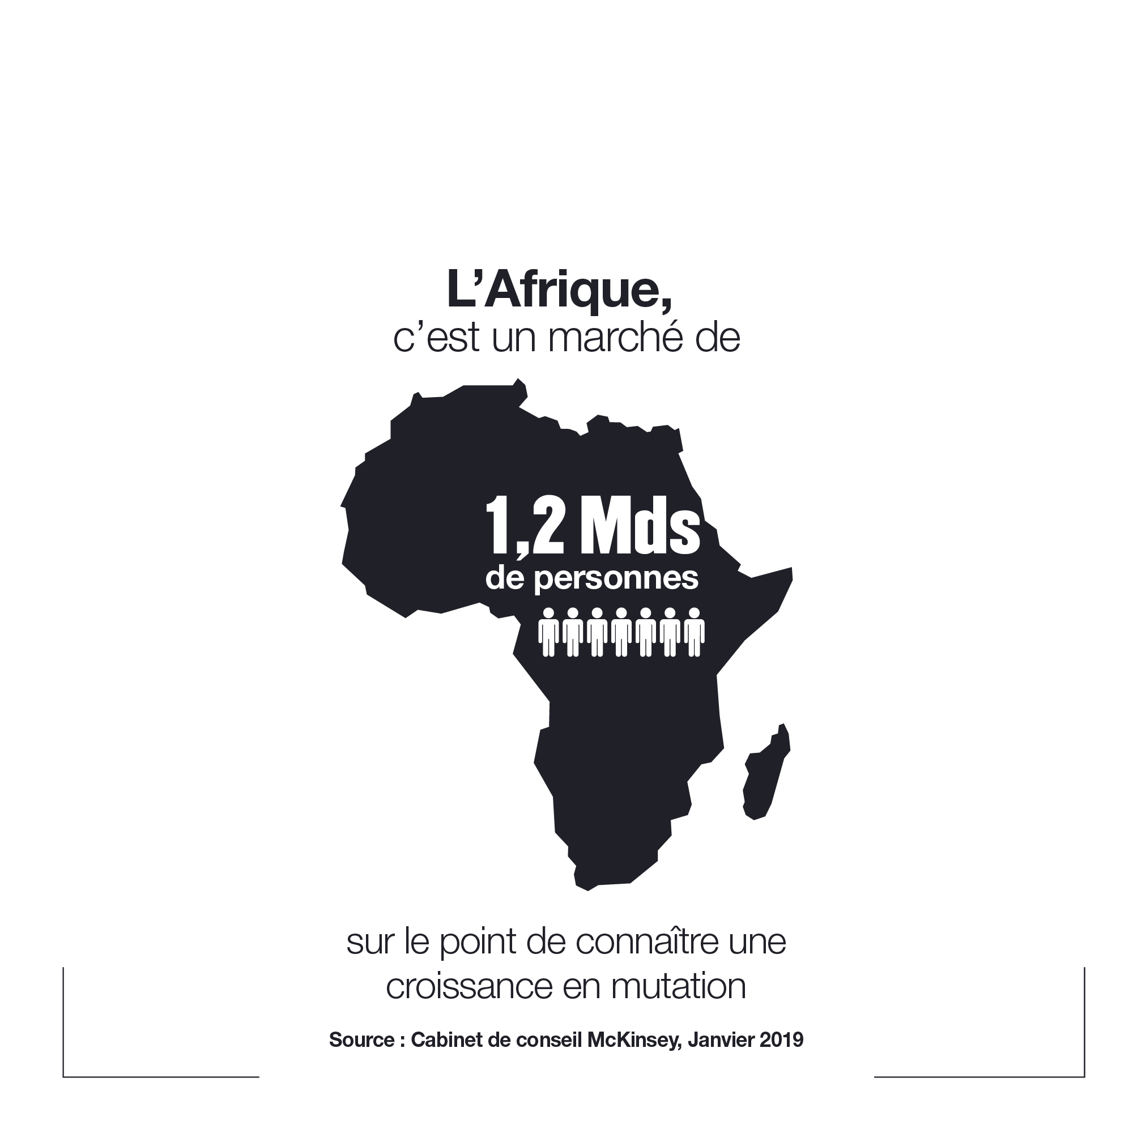
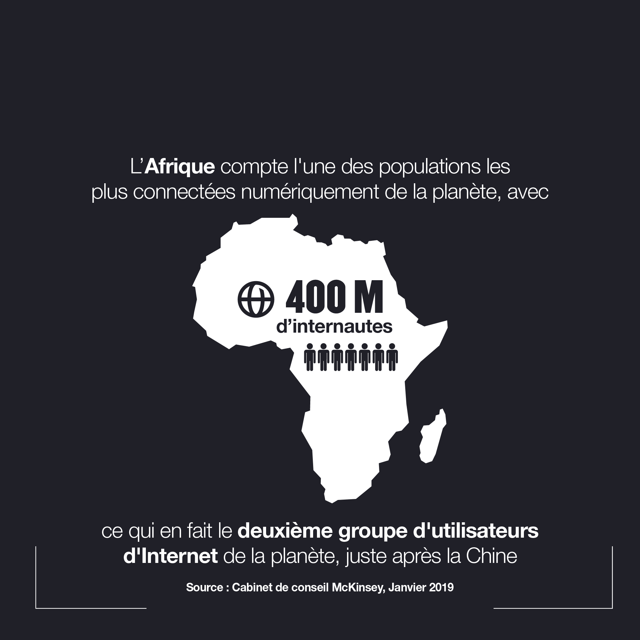

Slide 3

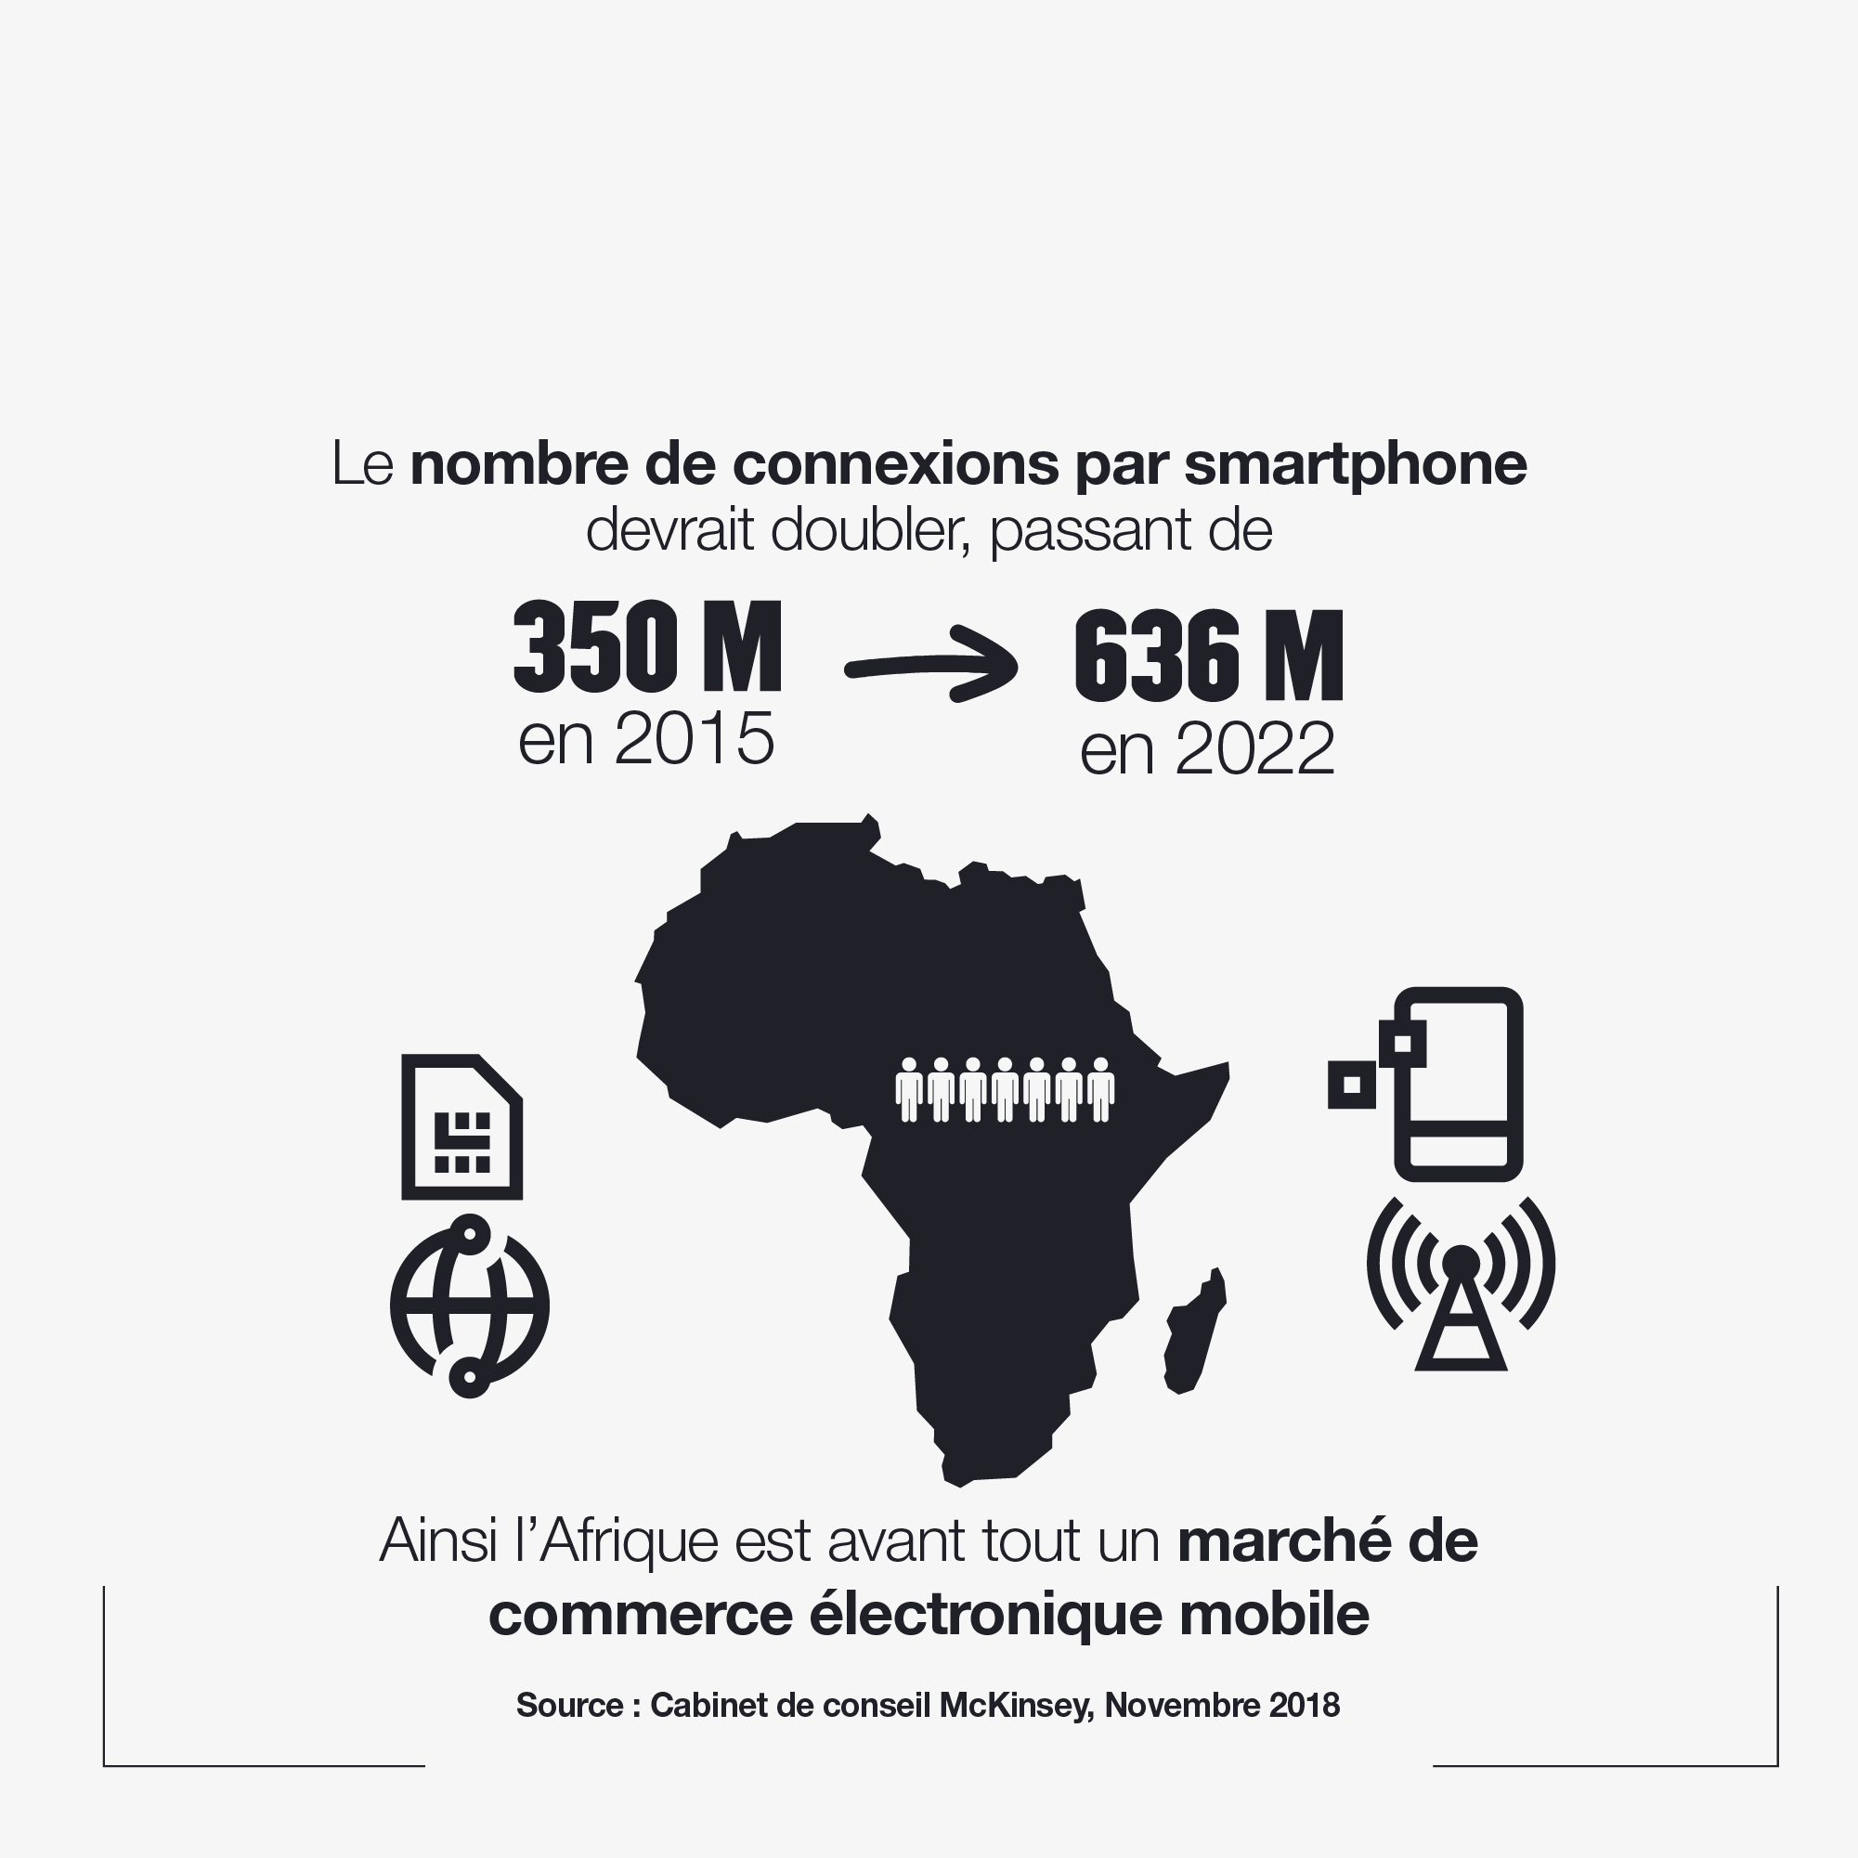

Slide 4
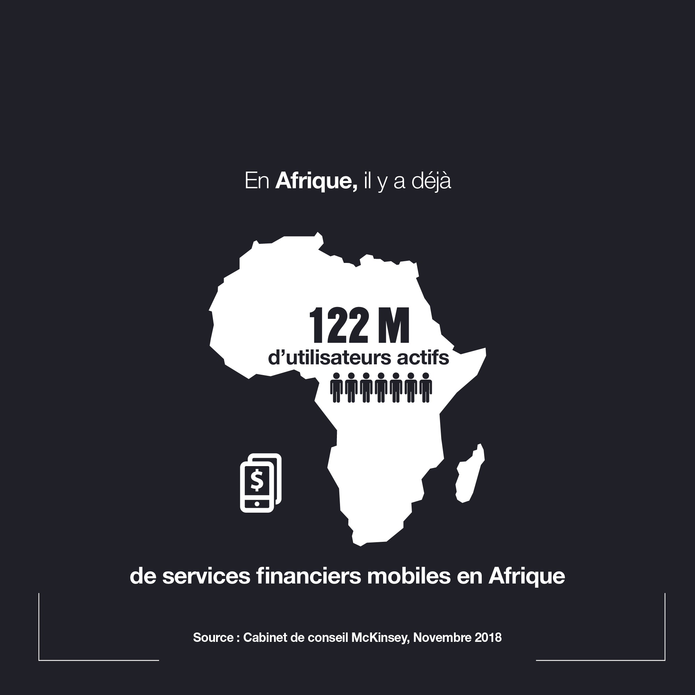
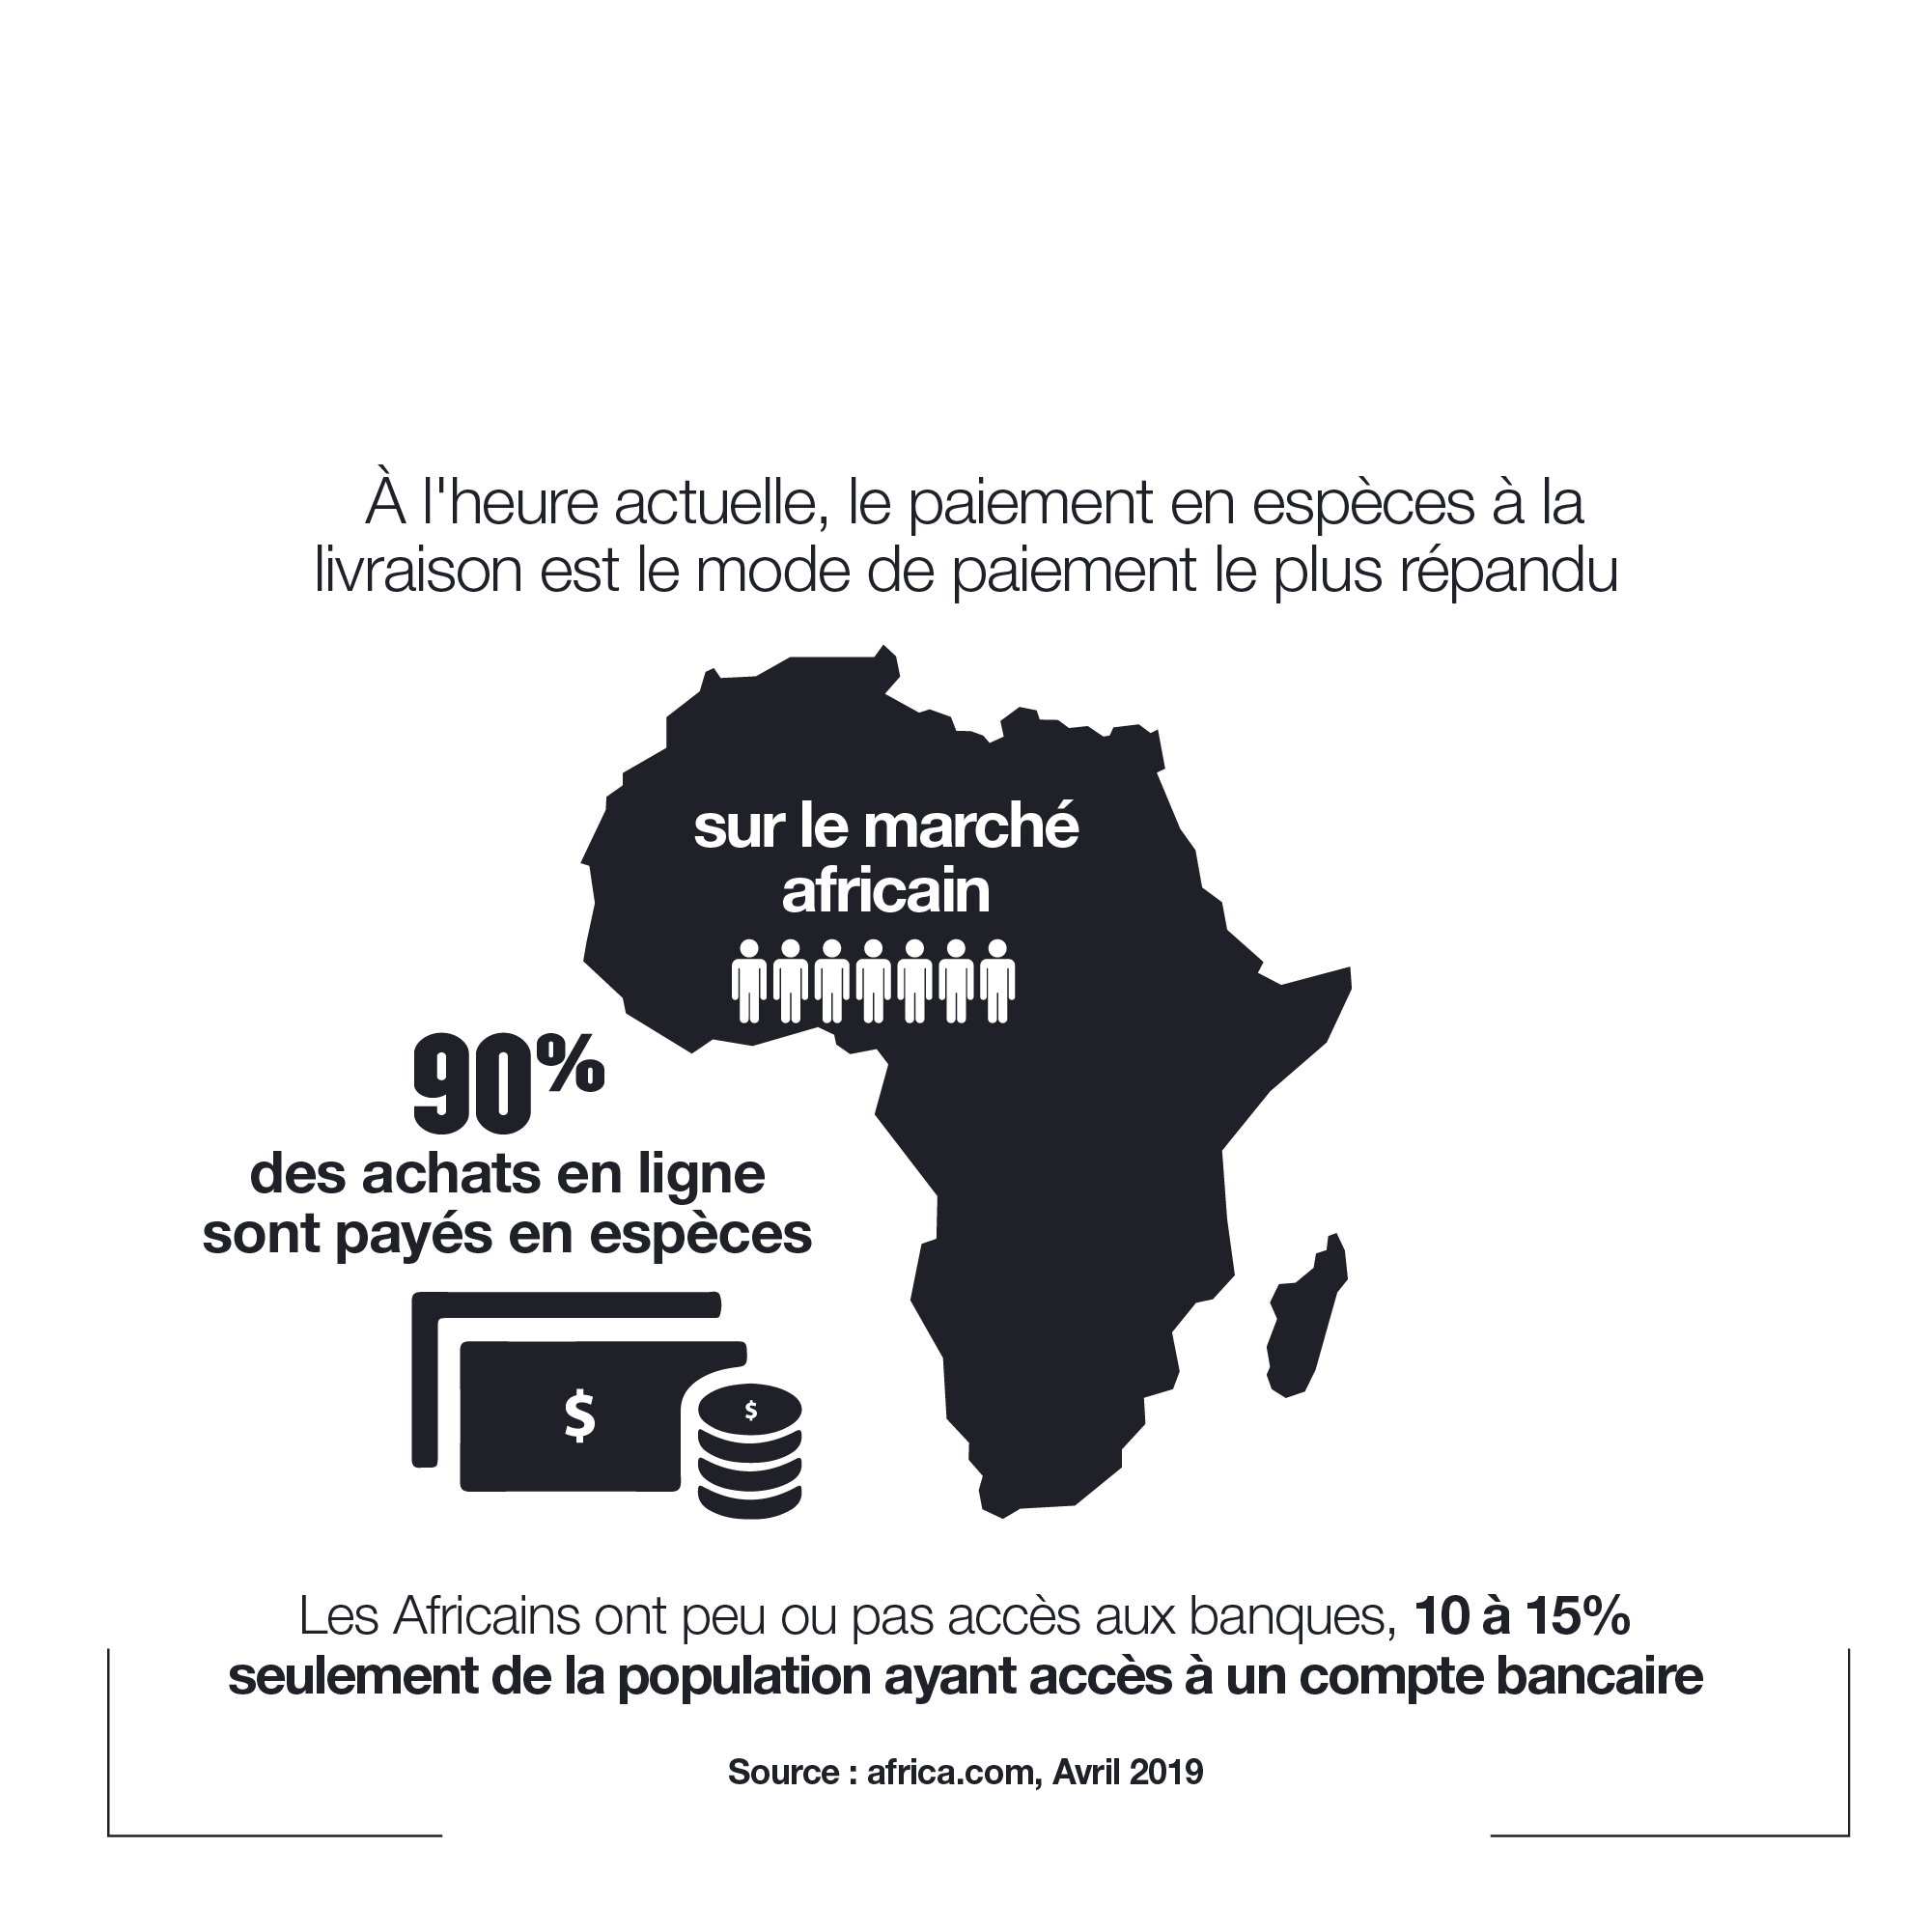

Slide 5
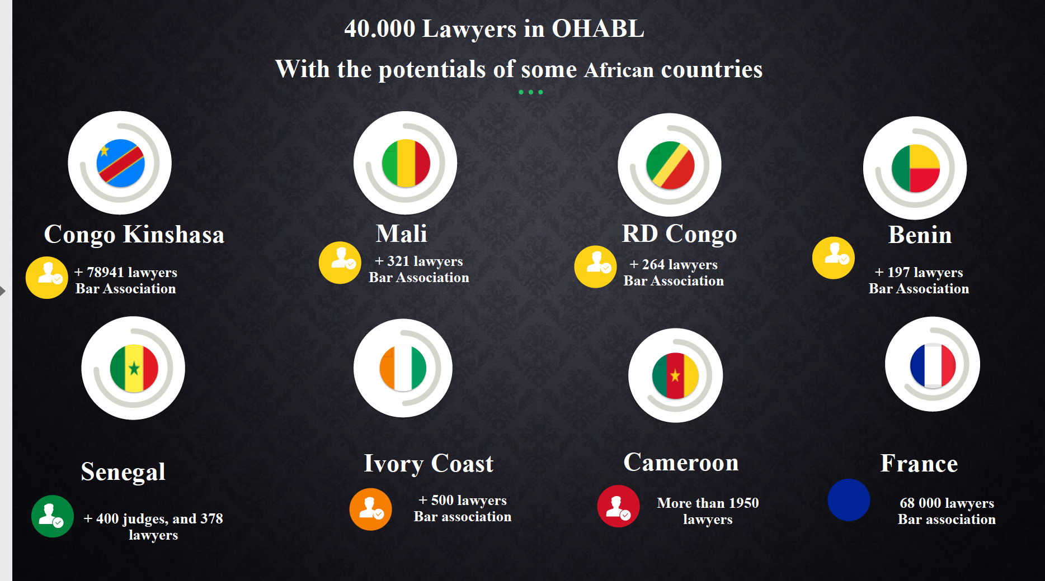

Slide 6
`
Prospects
Legal Counsel
Law Professors
Judges
Law students
SME and Big Organization preventing justice
Citizens
Lawyers

Slide 7

Particularity in Senegal
100%
Have an income that exceeds the average income in their country
95%
Live in the capital and also in economic cities
100%
Have a smartphone for them and have access to the internet
More magistrates than lawyers and they are the mouth of the law

Slide 8
Developer Icons for PowerPoint
Technologies
CSS
Javascript
we used these last technologies to make the presentation of the product and a demo of the functioning of the tool to allow the prospects to make a first use of our tool of legal intelligence.
HTML
HTML

Slide 9
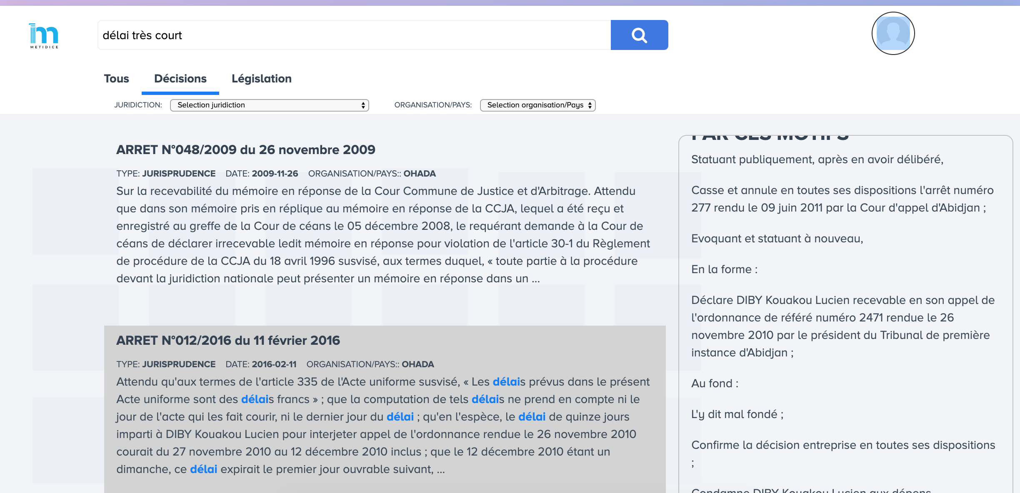
The product

Slide 10
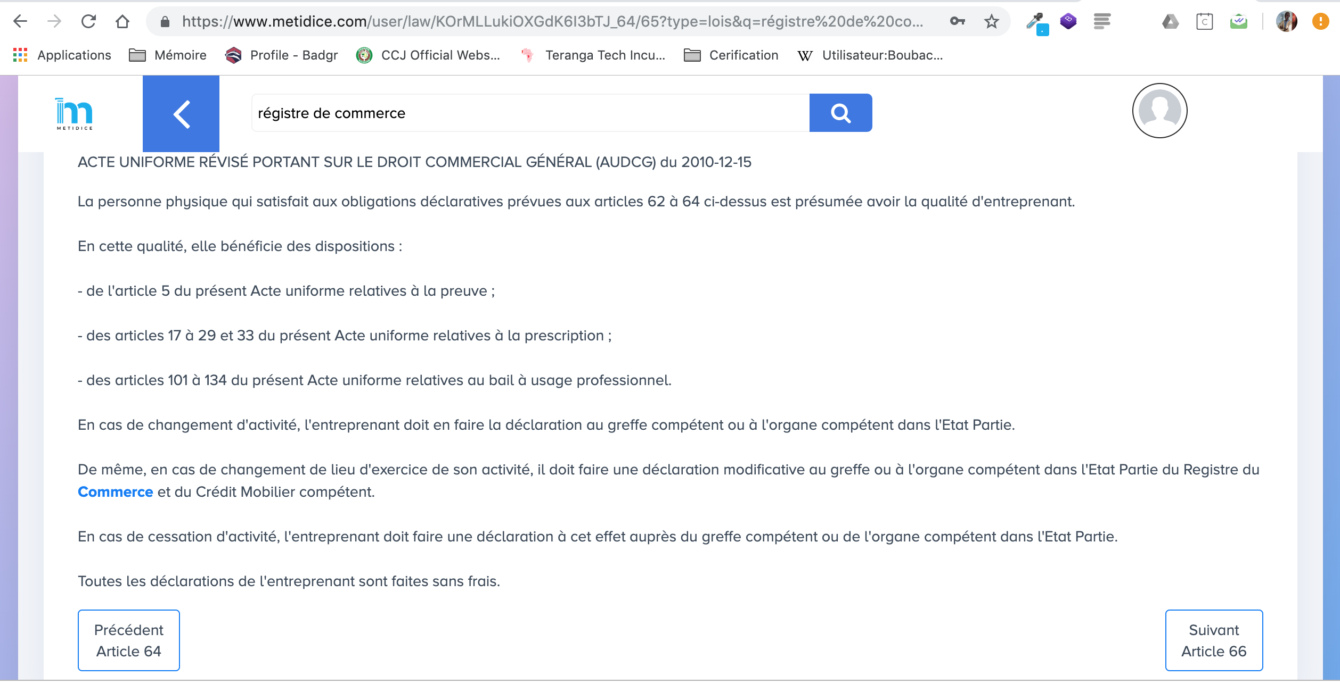

Slide 11
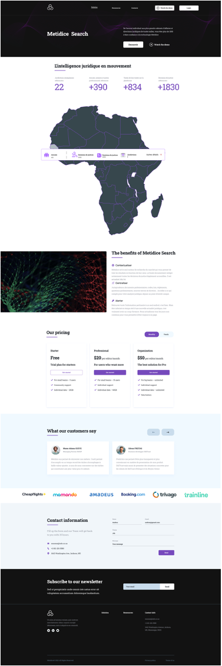
The new Product

Slide 12
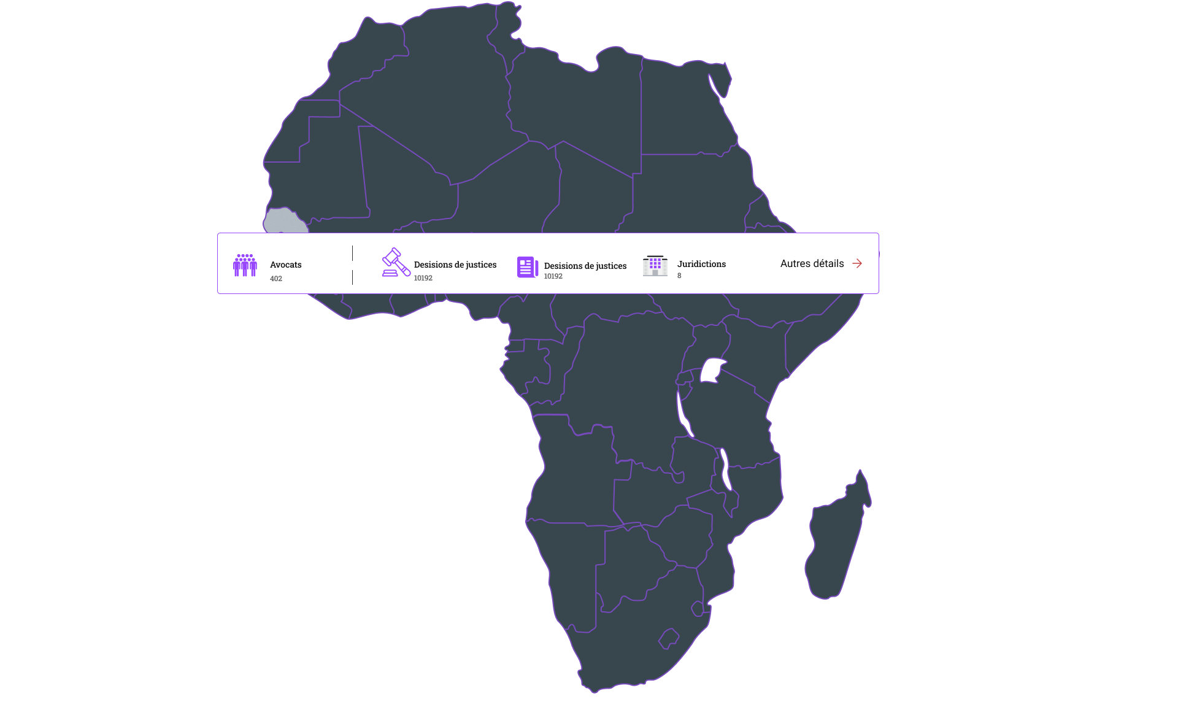
The new Product

Slide 13







Competitors

Slide 14
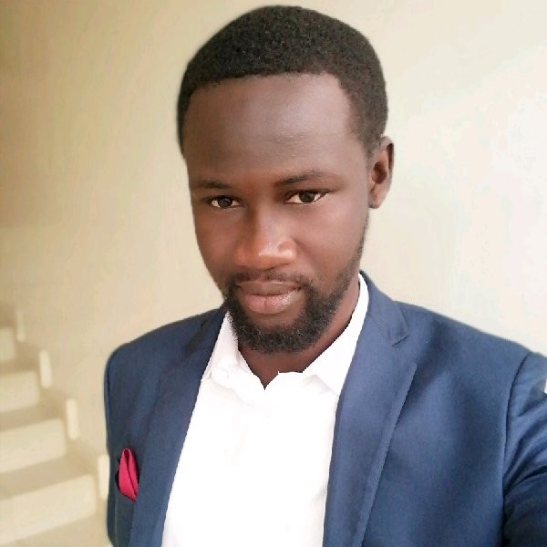
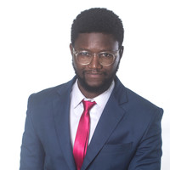
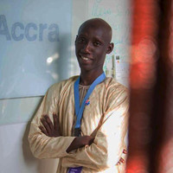
Team
Bamba TOUNKARA
Djibril SOW
Software Engineer
Blockchain Lover & Expert
Software Engineer
AI Expert
Boubacar FAYE
Product Manager
Legaltech /Legal Ops
Notes:
Source Image:-
https://unsplash.com/photos/aVbR17HLZTg

Slide 15
Roadmap
Metidice Search
First Semester
Product development
Commercialization
2019
2023
2023
2023
2024
New product launch
Pevelopment of new features
Second Semester

Slide 16
Do you have any questions?

Slide 17
Thank You.
Dakar Senegal.
77 696 48 81
Metidice
Metidice.search@gmail.com

